Slide 1
PICTIONARY
Group Members
Pratham Gawli - 2213192
Vrajesh Hegde - 2213209
Raghav Rathi - 2113208
Supervisor
Prof. Vaibhav Ambhire

Slide 2
Introduction
Pictionary is a multiplayergame.
A drawer is responsible to make amazing sketch to represent an assigned word.
Rest all players are supposed to guess the word the drawer is sketching.
1

Slide 3
Introduction
Introduction
User can create rooms for their other friends to join.
Introduction
Objective is to collect most points to be declared the winner.
To score more points user must guess the words before other participants & make sketches that most people can guess.
2

Slide 4

Literature Review
Pictar.io
01
Advantages
Limitations
01
Offers advanced controls and features
01
The app's UI is not user-friendly
02
Multi-function wheel allows quick adjustments
02
Doesn't support private game rooms
03
Offers creative modes like shutter priority
3

Slide 5

Literature Review
Drawasaurus
01
Advantages
Limitations
01
Promotes social interaction and teamwork
01
Have minor UI bugs
02
Easy to interact and engage
02
Requires stable internet connectivity
03
Offers numerous words and phrases for players to draw and guess
4

Slide 6
Problem Statement
Develop an interactive multiplayer game where one player sketches an image and other players participate in real-time by guessing the drawn image.
Introduction
5

Slide 7
Components
Create or Join Room
Live Canvas
Live Chat Box
Timer
Leaderboard
6

Slide 8
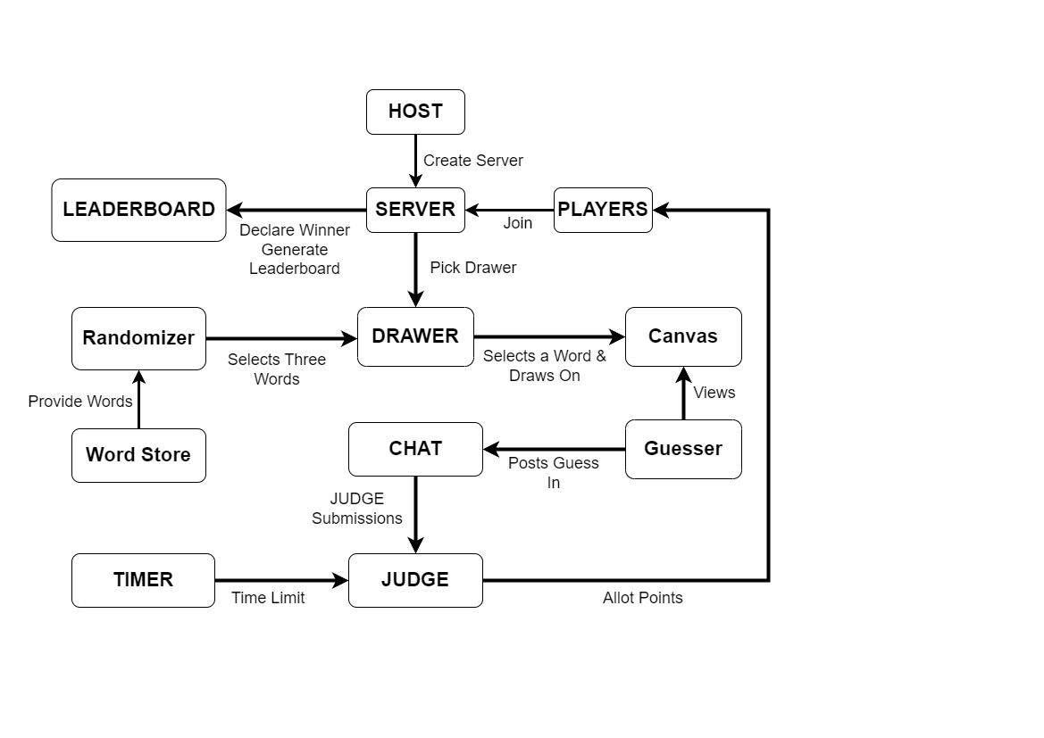
Architecture
Introduction
7

Slide 9

TECHNOLOGY
Introduction
Flutter is an open source framework by Google for building beautiful, natively compiled, multi-platform applications from a single codebase.
8

Slide 10

TECHNOLOGY
Introduction
Node.js is an open source server environment.
It allows us to run JavaScript on the server.
9

Slide 11

TECHNOLOGY
Introduction
Socket.IO is an event-driven library for real-time web applications. It enables real-time, bi-directional communication between web clients and servers.
10

Slide 12

TECHNOLOGY
Introduction
MongoDB is an open-source document-oriented database that is designed to store a large scale of data and also allows you to work with that data very efficiently. It is categorized under the NoSQL database
11

Slide 13

References
https://www.drawasaurus.org/
https://pictar.io/#/landing
https://flutter.dev/
https://nodejs.org/en

Slide 14


Thank You

